Slide 1
Cryptocurrency High-Frequency Trading Strategy based on Orderbook Behavior
Lynn, 朱致伶
2024/10/07 ML_FinTech Project Slide

Slide 2
Motivation
Design of Analysis
Data
4. Method
5. Experiment and Result
6. Strategy Design and Back Testing
7. Conclusion
Pre-processing
Feature engineering
Exploratory data analysis
IDA Template

Slide 3
Motivation
Motivation
Cryptocurrency market is renowned for its high volatility and fragmented liquidity across different exchanges.
Orderbook Behavior which reflects real-time market, related to price, volume and liquidity conditions.
Goal: Develop a cryptocurrency trading predictive model with orderbook data.
Why the project is important:
Study on Orderbook data and behavior
Risk Management through Liquidity
Practical use of machine learning model
IDA Template

Slide 4
Design of Analysis
Design of Analysis
Data Collection
and Preprocessing
Data Featuring
Model Training and Optimization
Crawl order book data From Binance API, implement rolling window approach.
Design and craft meaningful feature from raw data.
Design and train different models, including:
Linear regression
Super vector machine
XGBoost
Long-short term machine
Model Evaluation
Strategy Design and Back Testing
Conclusion
Assess model performance employed metrics MSE, RMSE, MAE, R^2.
Design trading strategy based on trained model and back test model with market indicators.
Sharpe Ration (SR)
Maximum Drawdown (MDD)
Profitability (Win Rate)
Interpret model performance and propose a strategy.

Slide 5
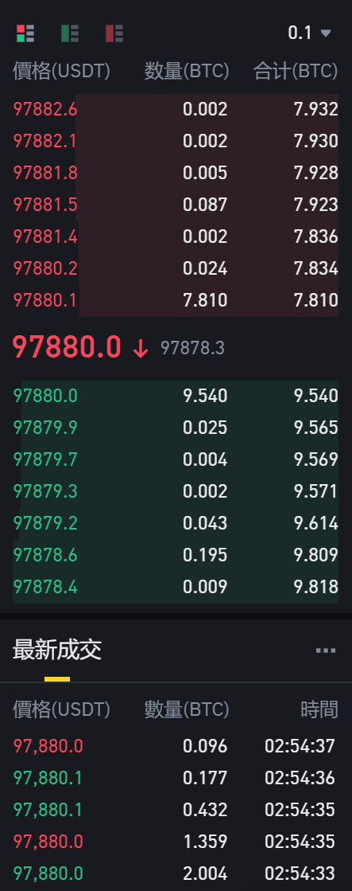
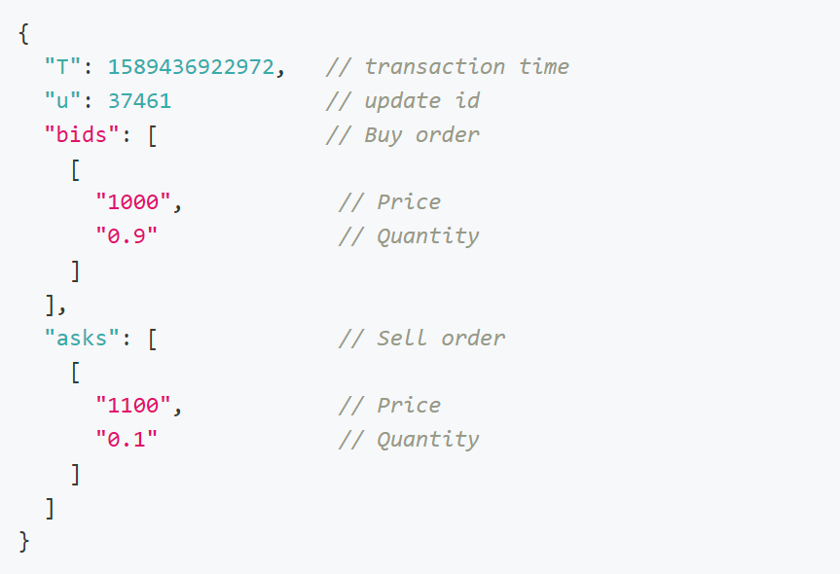
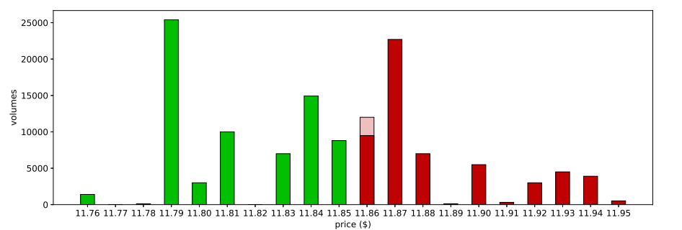
Data
Data
Binance Order Book API : BTC/USDT
Response example
Order book data schematic diagram
IDA Template

Slide 6
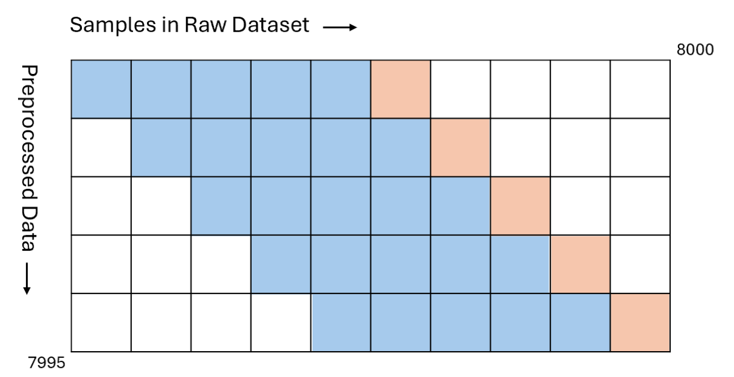
Data
Data and Pre-processing
Bitcoin (BTC) paired with Tether (USDT)
Market Dominance
Liquidity
Price Stability
Data Quality
Implement rolling window approach
IDA Template

Slide 7
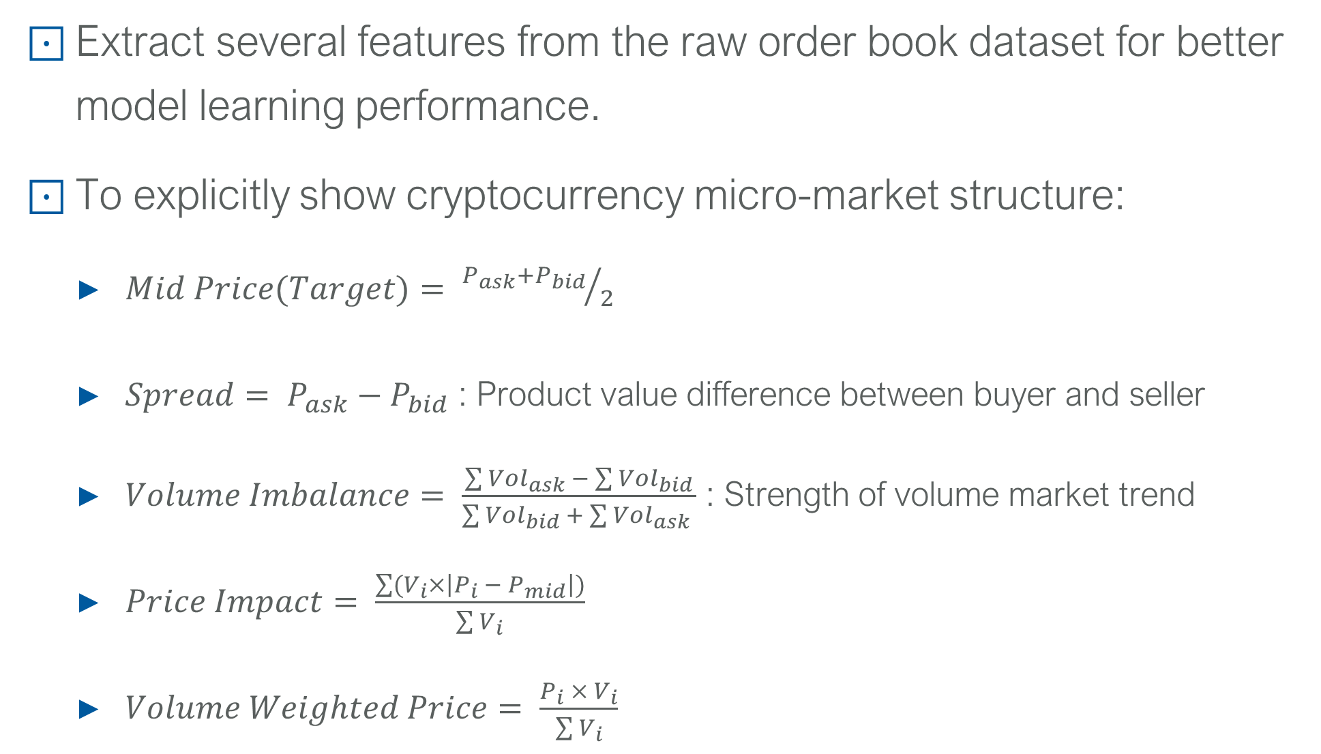
Data
Feature Engineering
Extract several features from the raw order book dataset for better model learning performance.
To explicitly show cryptocurrency micro-market structure:
$Mid Price(Target)= {P_{ask}+P_{bid}}/2$
$Spread= P_{ask}−P_{bid}$ : Product value difference between buyer and seller
$Volume Imbalance= \frac{\sum{{Vol}_{ask} − \sum{{Vol}_{bid}}}}{\sum{{Vol}_{bid} + \sum{{Vol}_{ask}} }}$ : Strength of volume market trend
$Price Impact= \frac{\sum{(V_{i}×\left|P_{i} − P_{mid}\right|)}}{\sum{V_{i}}}$
$Volume Weighted Price= \frac{P_{i} × V_{i}}{\sum{V_{i}}}$
IDA Template

Slide 8
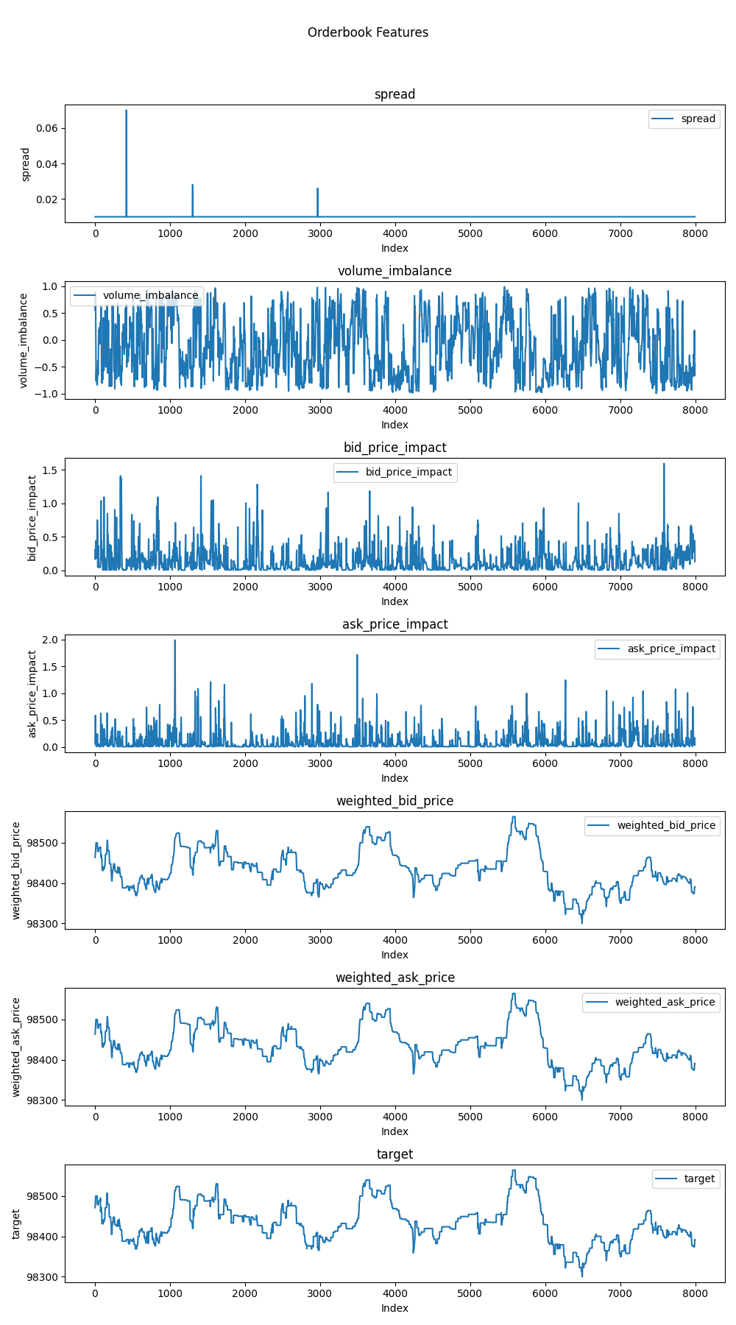
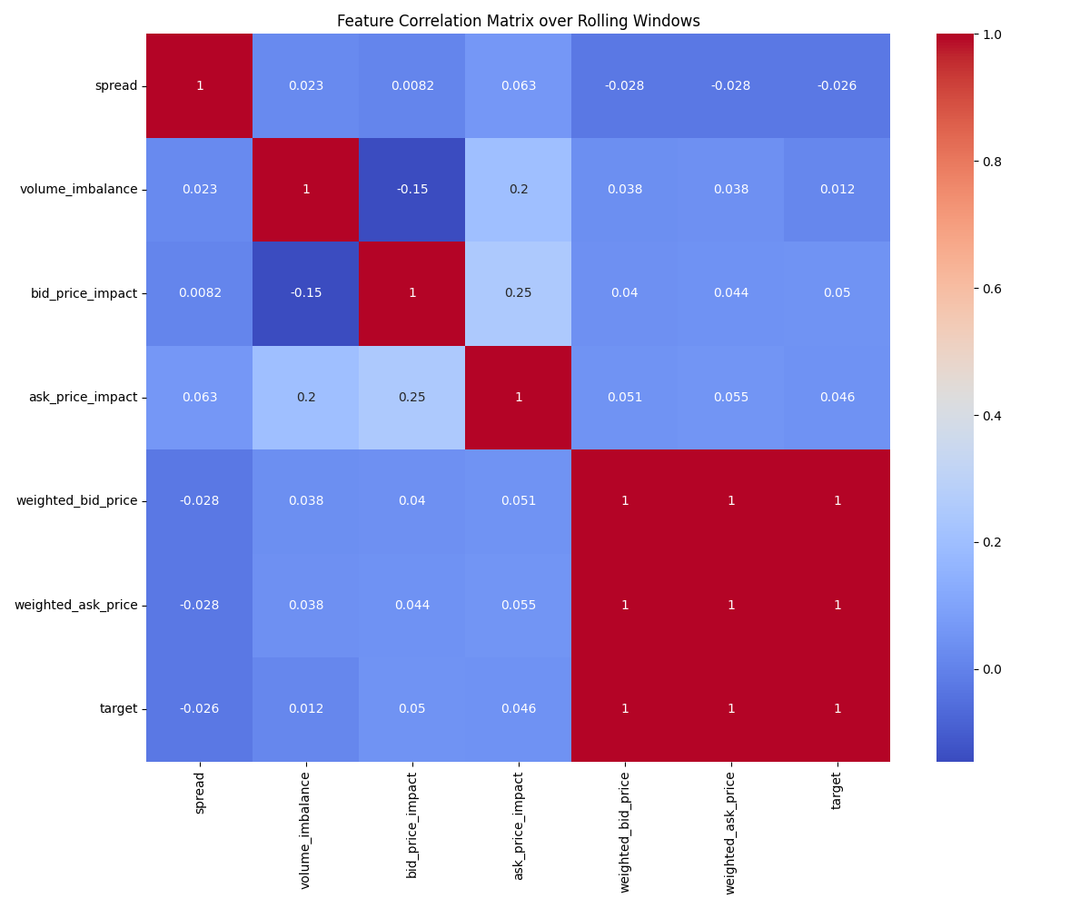
Data
Exploratory Data Analysis
Data distribution
Correlation heatmap
IDA Template

Slide 9
Method
Method
Split dataset to training(70%) and testing(30%)
Train and optimize the below machine learning model
Method | Purpose | Advantages | Disadvantages | Use Cases
Linear Regression | Predict continuous values | Simple, interpretable, efficient | Assumes linearity, sensitive to outliers | Price prediction, trend analysis
Support Vector Regression (SVR) | Predict continuous values | Effective in high dimensions, flexible kernel | Computationally expensive, sensitive to parameters | Stock price prediction, regression tasks
XGBoost | Boosting for predictions | Handles large datasets, regularization | Complex to tune, overfitting possible | Classification, regression tasks
LSTM | Sequence prediction | Captures temporal dependencies | Computationally expensive, requires tuning | Time series, speech recognition
Title

Slide 10
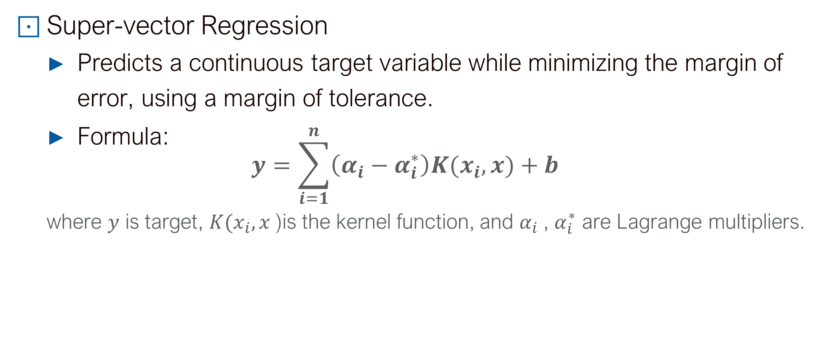
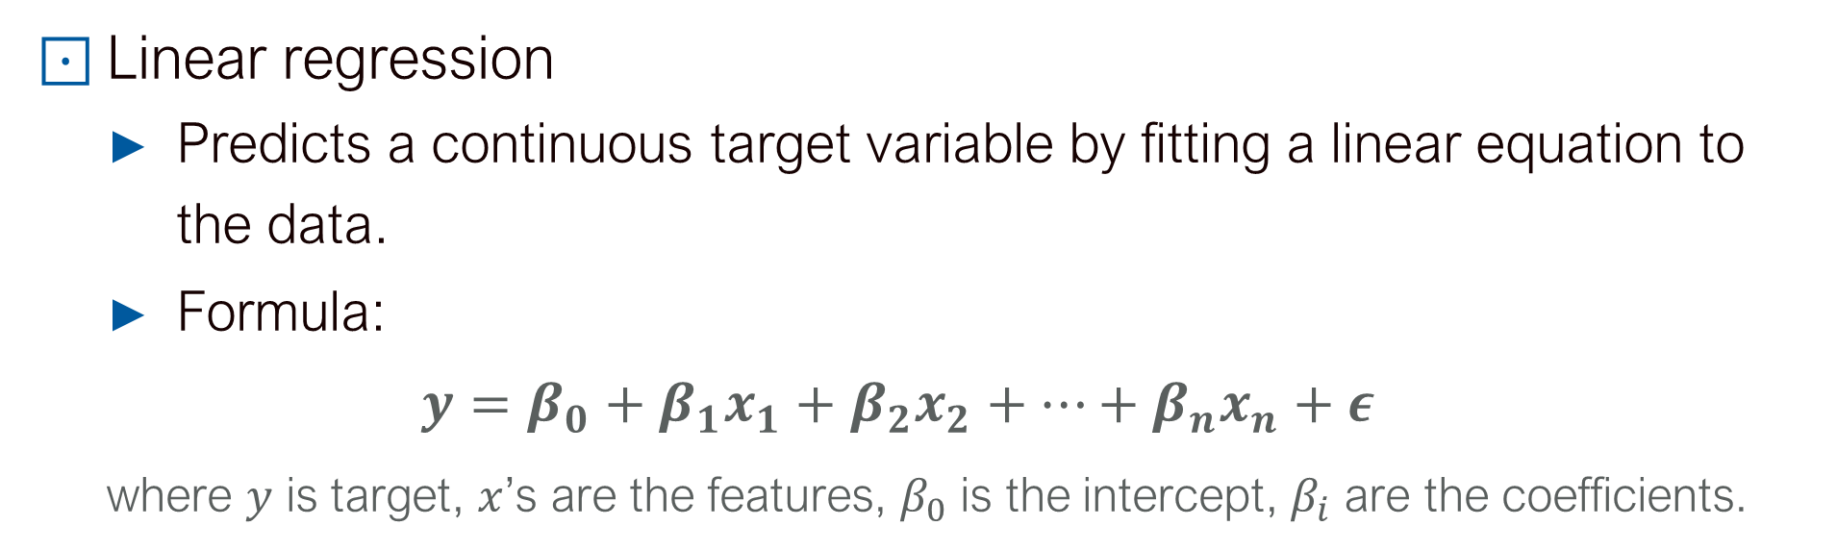
Method
Method
Linear regression
Predicts a continuous target variable by fitting a linear equation to the data.
Formula:
$$y=β_{0}+β_{1}x_{1}+β_{2}x_{2}+…+β_{n}x_{n}+ε$$
where $y$ is target, $x$’s are the features, $β_{0}$ is the intercept, $β_{i}$ are the coefficients.
Super-vector Regression
Predicts a continuous target variable while minimizing the margin of error, using a margin of tolerance.
Formula:
$$y=\sum_{i=1}^{n}{\left(α_{i}−α_{i}^{∗}\right)K(x_{i}, x)}+b$$
where $y$ is target, $K(x_{i}, x$)is the kernel function, and $α_{i}$, $α_{i}^{∗}$ are Lagrange multipliers.

Slide 11
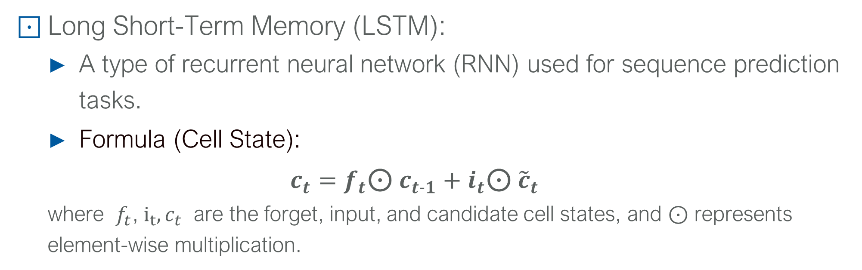
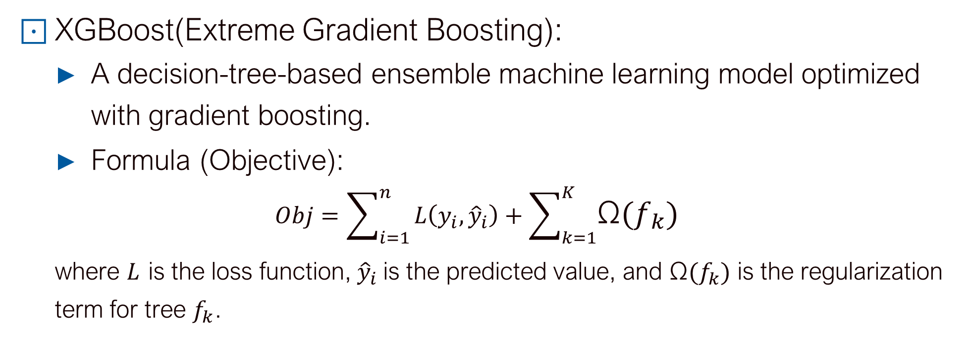
Method
Method
XGBoost(Extreme Gradient Boosting):
A decision-tree-based ensemble machine learning model optimized with gradient boosting.
Formula (Objective):
$$Obj=\sum_{i=1}^{n}{L\left(y_{i}, {\hat{y}}_{i}\right)+\sum_{k=1}^{K}{\text{Ω}(f_{k})}}$$
where $L$ is the loss function, ${\hat{y}}_{i}$is the predicted value, and $\text{Ω}(f_{k})$ is the regularization term for tree $f_{k}$.
Long Short-Term Memory (LSTM):
A type of recurrent neural network (RNN) used for sequence prediction tasks.
Formula (Cell State):
$$c_{t}=f_{t}\text{⊙}{ c}_{t-1}+i_{t}\text{⊙}{ \tilde{c}}_{t}$$
where ​ $f_{t}$, $i_{t}{, c}_{t}$ are the forget, input, and candidate cell states, and ⊙ represents element-wise multiplication.

Slide 12
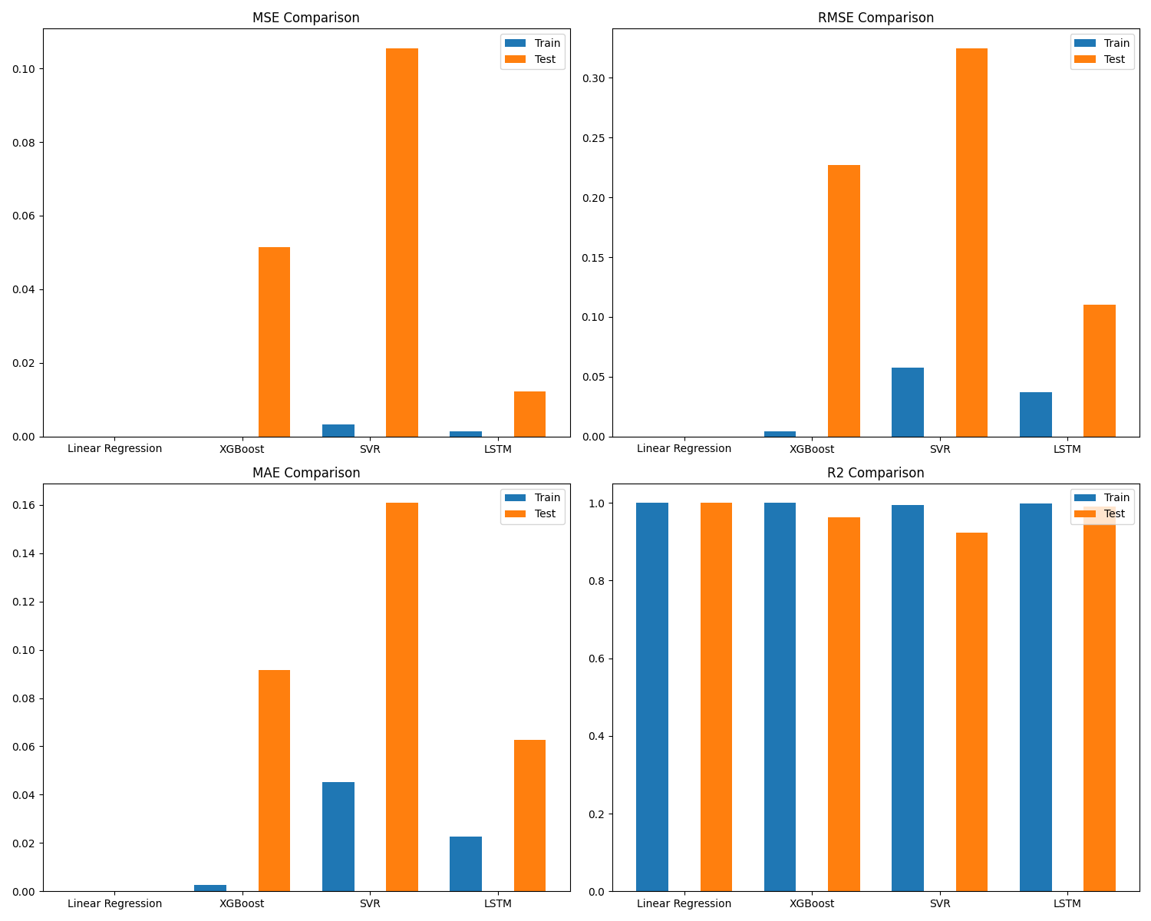
Model Performance Evaluation
Model Performance Evaluation
Model Performance on Testing Dataset
 | MSE | RMSE | MAE | R2
LR | 0.0 | 0.0 | 0.0 | 1.0
XGBoost | 0.0 | 0.017 | 0.01 | 0.999
SVR | 0.015 | 0.121 | 0.063 | 0.952
LSTM | 0.002 | 0.042 | 0.028 | 0.994
MSE: Mean Square Error
RMSE: Root Mean Square Error
MAE: Mean Absolute Error
R2: R square
Title

Slide 13
Trading Strategy and Back Testing
Trading Strategy and Back Testing
Predictions from the models are translated into trading signals based on thresholds (θ) derived from historical analysis with θ = 0.001:
Trading strategy determine the best time to buy/sell cryptocurrency with Price Rate of Change per second.
Signal = 1 if (P_pred - P_current) / P_current > θ
Signal = -1 if (P_pred - P_current) / P_current < -θ
Signal = 0 otherwise
A stop-loss mechanism is integrated to mitigate potential risks from adverse price movements.
Title

Slide 14
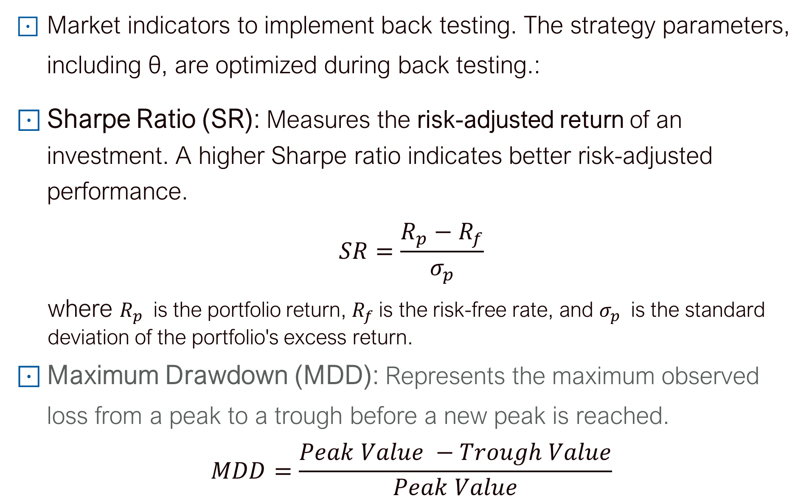
Trading Strategy and Back Testing
Back Testing
Market indicators to implement back testing. The strategy parameters, including θ, are optimized during back testing.:
Sharpe Ratio (SR): Measures the risk-adjusted return of an investment. A higher Sharpe ratio indicates better risk-adjusted performance.
$$SR=\frac{R_{p}−R_{f}}{σ_{p}}$$
where $R_{p}$​ is the portfolio return, $R_{f}$is the risk-free rate, and $σ_{p}$​ is the standard
deviation of the portfolio's excess return.
Maximum Drawdown (MDD): Represents the maximum observed loss from a peak to a trough before a new peak is reached.
$$MDD=\frac{Peak Value −Trough Value}{Peak Value}$$

Slide 15
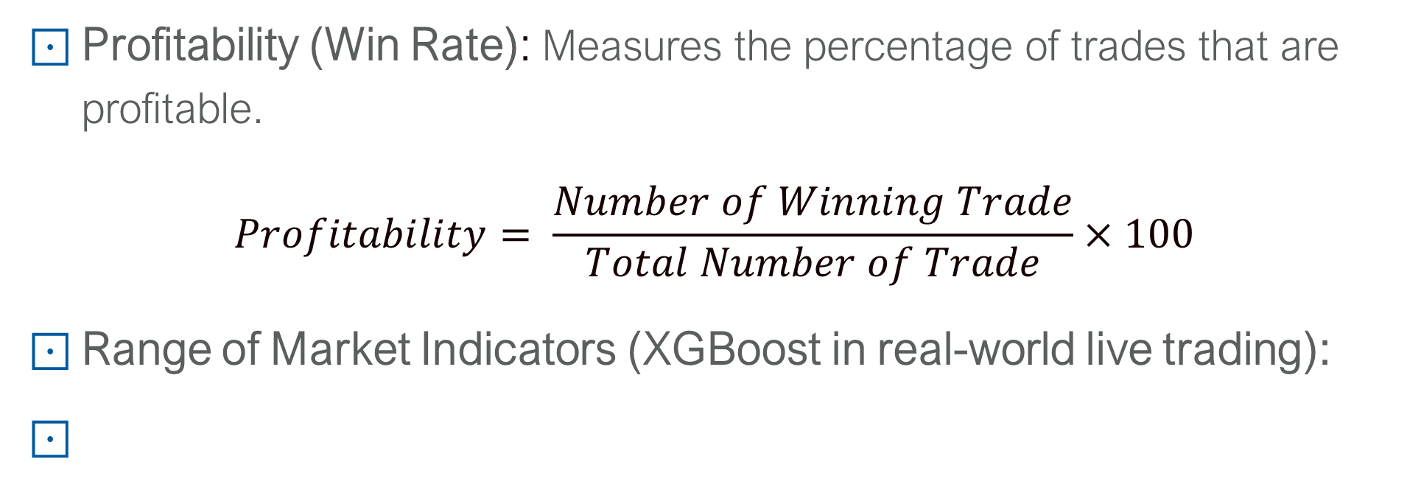
Trading Strategy and Back Testing
Back Testing and Mocked Live Trading Implementation
Profitability (Win Rate): Measures the percentage of trades that are profitable.
$$Profitability= \frac{Number of Winning Trade}{Total Number of Trade}×100$$
Range of Market Indicators (XGBoost in real-world live trading):
Metric | Common Range | Good Trading Strategy (Good/Excellent) | XGBoost
Sharpe Ratio | 0 ~ 3 | >1.5 / >2.0 | -0.034
Maximum Drawdown | 10% ~ 100% | >20% / >10% | 80%
Profitability | 40% ~ 60% | >55% | -8%

Slide 16
Motivation
Conclusion
In the project, …
Crawl meaningful orderbook feature from raw data.
Train four machine learning model, and compare the performance. XGBoost has the best model performance among four ML model.
Develop trading strategy based on learned model.
Implement back testing on trained XGBoost in real-world live trading environment, model performance is under expectation.
IDA Template

Slide 17
Styleguide
Future Work
Study relationship between simple and complex data and learning model.
Design and modify ML structure, tune model parameters to handle real-world trading environment.
Reference
Binance Order Book API: https://developers.binance.com/docs/derivatives/option/market-data/Order-Book
The Short-Term Predictability of Returns in Order Book Markets: a Deep Learning Perspective
IDA Template

